Slide 1
Lane Line Detection
Group Members:
Muhammad Osairam Waheed – 1230098
Fayaz Khan – 1218362
Arsalan Ali – 1228886
Zian Ali – 1229890

Slide 2
Introduction
Role of Lane Lines in Driving
Essential visual reference for human drivers.
Significance for Autonomous Vehicles
Critical for safe and accurate navigation.
Detection Process Overview
Image acquisition, preprocessing, edge detection, and line fitting.
Technological Foundations
Machine learning and computer vision techniques.

Slide 3
Problem Statement
Enhancing Driving Experience
Developing lane line detection to improve navigation accuracy and safety for autonomous vehicles.
Integration with Advanced Driver Assistance Systems (ADAS)
Contributing to comprehensive ADAS for better decision-making and maneuvering.
Improving Autonomous Vehicle Performance
Ensuring precise lane detection to enhance the overall performance and reliability of self-driving cars.
Safety and Efficiency
Reducing the risk of accidents by providing accurate lane keeping and lane departure warnings.

Slide 4
Objectives
Accurate Lane Detection:
It must easily detect the lane lines on the road.
Real-time detection:
Ensure the system processes video frames quickly enough to provide real-time feedback.
Lane with the alert line:
It should monitor the lane regularly and alert the driver if he crosses this line.
Robustness:
It must be able to detect lane lines under varying weather conditions, lighting conditions, and different road types.

Slide 5
Dataset
Dataset Composition
Sequence of images captured by an onboard vehicle camera.
Includes diverse road conditions: bumpy roads, curved lanes.
Comprehensive Scenario Coverage
All levels of significance occurring in on-road driving.
No assumption of consistent lane colors; includes varied lane markings.
Variability and Realism
Dataset designed to mimic real-world driving conditions.
Aims to train robust and adaptable lane detection algorithms.

Slide 6
Dataset
Training Data
Collection of videos covering:
Different driving scenarios: highways, city roads, country roads, etc.
Various weather conditions: sunny, rainy, nighttime, dawn, dusk, etc.
Test Data
Separate set of video data distinct from training data.
Ensures model generalizes well to new, unseen driving scenarios.

Slide 7
Model
Canny Edge Detection
Utilizes the well-known Canny method to detect edges.
Highlights high-intensity gradient areas to find line boundaries.
Hough Transform
Detects straight lines in the edge-detected image.
Converts line detection into a parametric space for easier identification.
Polynomial Fitting
Models detected lane lines as smooth and continuous curves.
Ensures accurate representation of lane lines, even if they are not perfectly straight.

Slide 8
Model
Lane Departure Warning System
Calculates the vehicle's position relative to detected lane lines.
Issues warnings for lane deviation based on heuristics and geometric calculations.

Slide 9
Methodology
Image Processing
Grayscale Conversion: Simplifies the process and reduces computational complexity by converting the input image to grayscale.
Gaussian Blur: Reduces noise and smooths the image to aid in more accurate edge detection.
Edge DetectionCanny
Edge Detection: Detects edges using Canny’s algorithm, identifying and connecting strong and weak edges to form continuous edges.

Slide 10
Methodology
Region of Interest Masking
Masking: Applies masks to focus on the bottom half of the image, eliminating noise and highlighting the area of interest.
Line Detection
Hough Transform: Detects straight lines in the masked, edge-detected image by converting Cartesian coordinates into parametric space.
Lane Line Polynomial Fitting
Polynomial Fitting: Represents detected lane lines as smooth, continuous curves without sharp corners.

Slide 11
Methodology
Lane Departure Warning
Warning System: Calculates vehicle position relative to lane lines and issues notifications if the vehicle deviates from the lane center.
Overlaying Results
Overlay: Superimposes detected lane lines and warnings on the original image, with text annotations for warnings.
Video Processing Pipeline
Pipeline: Processes each frame of the input video to produce an output video with identified lane lines and warnings.

Slide 12
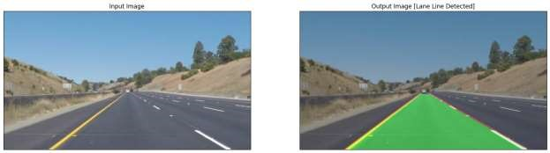
Results
This system was assessed on the test set, and the following results were reported:
Accuracy / IOU : The system accurately detected road markings well even in difficult conditions such as poor lighting and bad weather. IOU = 0.51439

Slide 13
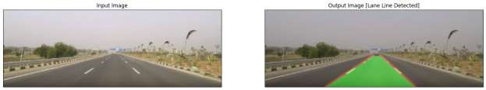
Results
Real-Time Performance: A pipeline was designed to process videos in real time so that lane departure warnings could be provided promptly. This is highly significant for driver assistance systems in practice.

Slide 14
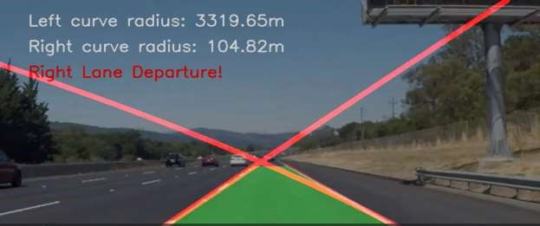
Results
Lane Departure Warning: When a vehicle deviated from its path, this method issued correct timely warnings. These would signal when it was time for the drivers to correct their movements.

Slide 15
Conclusion
In this project, we successfully achieved our objectives of developing an accurate and reliable lane line detection system for autonomous vehicles. By combining traditional computer vision techniques with heuristic-based approaches, our model demonstrated robust performance across diverse driving and weather conditions. The implementation of edge detection, region of interest masking, line detection, polynomial fitting, and lane departure warning mechanisms ensured precise lane identification and effective deviation alerts. Our methodology proved effective in real-time video processing, delivering consistent and dependable results. Overall, this project represents a significant step forward in enhancing the driving experience and promoting the safety and reliability of self-driving cars.

Slide 16


